Slide 1
COEN 6311: Travel Agency
Authors: Dinesh Kini, Sraddha Bhattacharjee, Jimi Mehta, Saketh Oppula, Sultan Singh

Slide 2
Product Goal
Experience seamless travel planning and booking with our user-friendly web application “Travel Agency”, offering a comprehensive selection of flights, hotels, and activities, all at your fingertips.

Slide 3
So lets start and dive more into the Project

Slide 4

Product Demo
Website: https://travel-package-management.herokuapp.com
Agent Login: aliceagent@gmail.com/ alice123
Customer Login: customer@gmail.com/ customer123

Slide 5
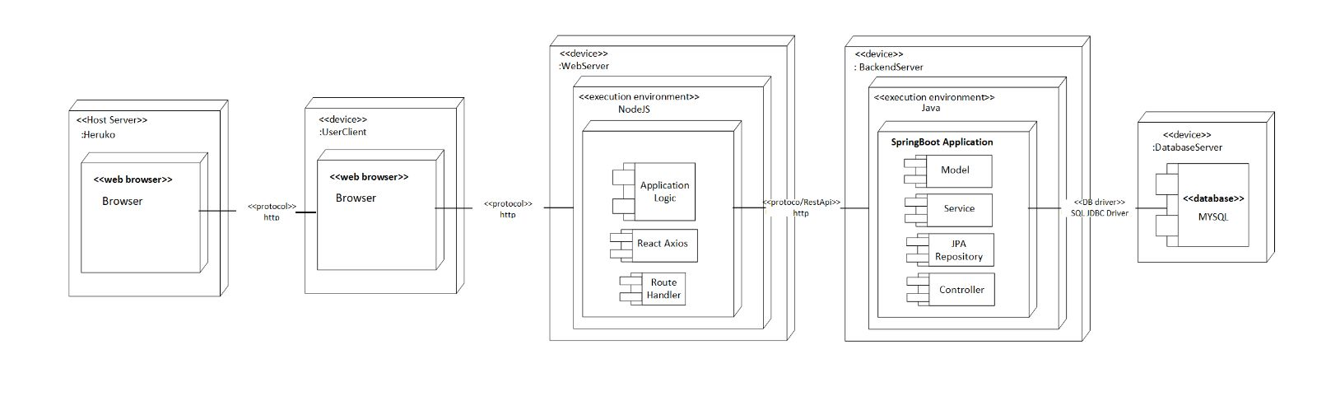
Deployment Diagram

Slide 6
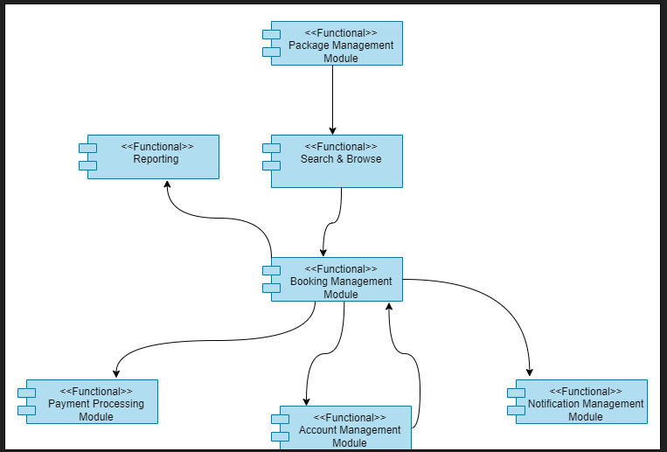
Functional Diagram

Slide 7
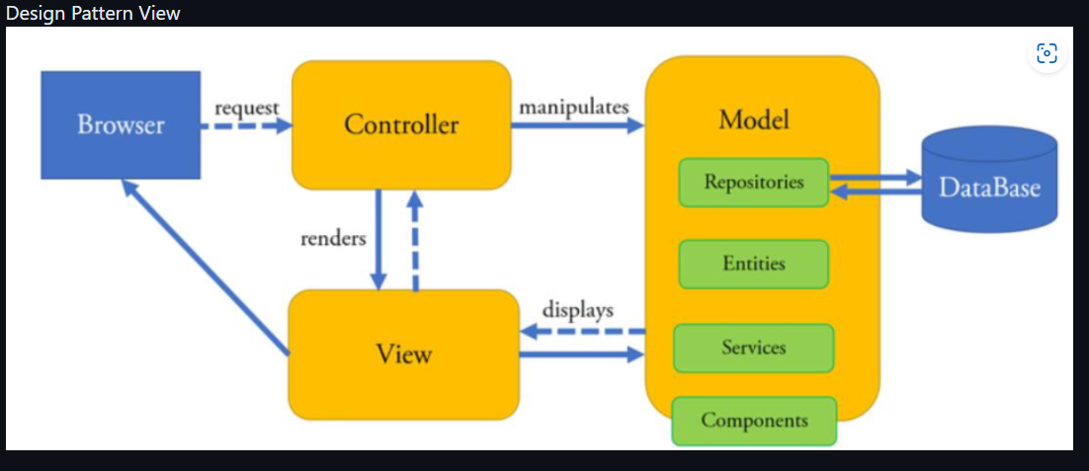

Slide 8
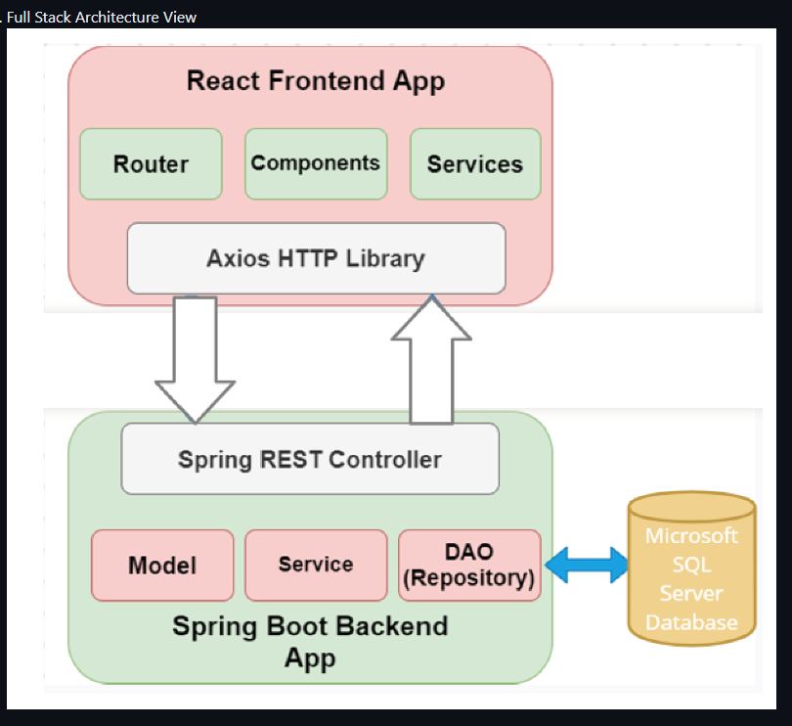

Slide 9
Team Process
During Sprint 1, our team faced challenges in adopting Agile development practices. Since we are all working, we tried to cap our weekly scrum meeting at 15 minutes. On weekends, we connected for 1-2 hours to resolve queries and actively sharing progress updates, collaborate on documentation and design diagrams.
The main challenges we faced were the short nature of the summer semester as well as differing work schedules. To navigate the time constraints, we employed two key strategies: promoting clear communication among team members via Zoom and leveraging Jira as our PM tool. These approaches enabled us to stay informed about each member's tasks, avoid redundant efforts, and effectively integrate different project components. We distributed workload equitably, supported one another in adopting and utilizing various tools, and proactively addressed neglected project areas to ensure balanced progress.
For Sprint 2, During Sprint 2, we primarily worked on the project's foundation. We greatly increased the amount of code in order to better implement the product functions, which caused our actual work time to be slightly longer than our anticipated work time. We also focused on creating and perfecting design diagrams, in this sprint.
For Sprint 3, we focused on integrating the Stripe. There was also significant documentation involved in this sprint, as compared to the previous 2 sprints. We also made a conscious decision to prioritize functionality over user experience, as we were on a time crunch.

Slide 10
Meeting Logs: Sprint 3 · SraddhaBhattacharjee/COEN6311AA_GGWP Wiki (github.com)
Sprint 1 : Sprint 1 · SraddhaBhattacharjee/COEN6311AA_GGWP Wiki (github.com)
Sprint 2: Sprint 2 · SraddhaBhattacharjee/COEN6311AA_GGWP Wiki (github.com)
Sprint 3 ( documentation in progress): Sprint 3 · SraddhaBhattacharjee/COEN6311AA_GGWP Wiki (github.com)

Slide 11
Team Roles
Dinesh Kini - Implementation Manager
Project Planning and Execution: Planning and executing the implementation of a software solution or system. They define project goals, develop a comprehensive project plan, allocate resources, and oversee the successful implementation, ensuring it is completed within budget and timeline constraints.
Maintain Code Base Repository: Periodic maintaining the code base repository, which involves organizing and structuring code files, ensuring proper documentation, and managing version control to track changes and facilitate collaboration among team members.
Version Control and Deployment: Version control systems like Git enable developers to manage code changes, track revisions, and collaborate effectively. Deployment involves the process of releasing software updates or new features to production environments, ensuring smooth transitions and minimizing disruptions for end-users.
Dev Testing: Perform dev testing to validate the functionality and quality of the code. Create and execute test cases, conduct unit testing, and identify and resolve any functional or logical issues before handing off the code for further testing.
Fixing Defects/Bugs, Functional and Technical Issues: Identifying and fixing defects and bugs reported during testing. Analyze and troubleshoot functional and technical issues, debug code, and implement necessary fixes to ensure the software operates as intended and meets the desired specifications.
Jimi Mehta - Scrum Master
Sprint Planning and Management: The Scrum Master played a pivotal role in the successful planning, execution, and closure of the three sprints, each consisting of two weeks. The Scrum Master ensured that sprint goals aligned with the project’s objectives, and managed any risks or issues that arose during the sprint.
Facilitation of Daily Scrum Meetings: During the project, the Scrum Master facilitated daily scrum meetings to track the progress of tasks, identify any blockers, and maintain team productivity. These sessions helped the team align with the sprint's goals and fostered communication and collaboration.
Advocate for Agile Principles: The Scrum Master acted as the custodian of Agile principles, ensuring that the team fully understood and adopted these principles during each phase of the project. This advocacy increased the team's agility, improved responsiveness to change, and led to higher quality software output.
Promotion of Continuous Improvement: Post each sprint, the Scrum Master facilitated sprint retrospectives. These sessions were used to reflect on what went well, what didn't, and how the team could improve in the next sprint. This practice fostered a culture of continuous learning and improvement within the team.
Stakeholder Communication and Reporting: The Scrum Master ensured transparent communication with stakeholders, including timely and accurate reporting of sprint progress, changes, and risks. This communication helped manage stakeholder expectations and increased their satisfaction with the project's progression.

Slide 12
Sraddha Bhattacharjee - Quality Manager
Monitoring and evaluating quality performance: The quality manager monitored and evaluated the team’s quality performance by conducting inspections and data analysis. They identified the areas for improvement and implement corrective and preventive actions.
Continuous improvement: Quality manager drove continuous improvement efforts by analyzing data, identifying trends, and implementing strategies to enhance quality and efficiency
Leadership and collaboration: Quality manager lead the team meetings. They acted as a liaison between customer (Professor, TA) and team to drive initiatives and resolve quality-related issues.
Creation of User Stories: Quality manager created user stories and tasks and ensured that each user story was up to the quality envisioned by the team, as per requirement.
Customer satisfaction management: They monitored customer feedback, complaints, and satisfaction levels to identify areas of improvement.
Saketh Oppula - Design Manager
Design Strategy: Develop and execute the design strategy for software projects, aligning it with the overall product vision and business goals. Collaborate with stakeholders to define design requirements, objectives, and success metrics.
Team Management: Lead and manage a team of designers, providing guidance, mentorship, and support. Assign tasks, set goals, conduct performance evaluations, and foster a collaborative and creative work environment.
Design Process: Define and implement efficient design processes that align with agile and Scrum methodologies. Work closely with the development team to ensure design integration and collaboration throughout the software development lifecycle.
User-Centric Design: Advocate for user-centric design principles and ensure that the team conducts user research, usability testing, and iterative design iterations to create intuitive and user-friendly software interfaces.
Collaboration and Communication: Collaborate with team members,, to gather requirements, prioritize features, and resolve design-related issues.
Sultan Singh - Support Manager
Team Coordination and Resource Management: Managing a support team, assigning tasks, and facilitating efficient collaboration. Assigned tasks in JIRA
Incident Management and Escalation: Promptly addressing critical issues, prioritizing tasks, and coordinating communication between teams and stakeholders.
Continuous Improvement and Knowledge Management: Identifying opportunities for process improvement, maintaining documentation, and enhancing the support experience.
Product Knowledge and Training: Keeping up-to-date with the software product's features and updates, and providing training to support staff to enhance their troubleshooting abilities.
Performance Monitoring and Reporting: Tracking support team metrics and providing regular reports to management for performance evaluation and improvement purposes.

Slide 13
Lessons Learnt
Link : Sprint 3 · SraddhaBhattacharjee/COEN6311AA_GGWP Wiki (github.com)

Slide 14
Thank You!

